Slide 1
For Live Session Assignment (FLS)
Unit 7

Slide 2
Quick Quiz Questions

Slide 3
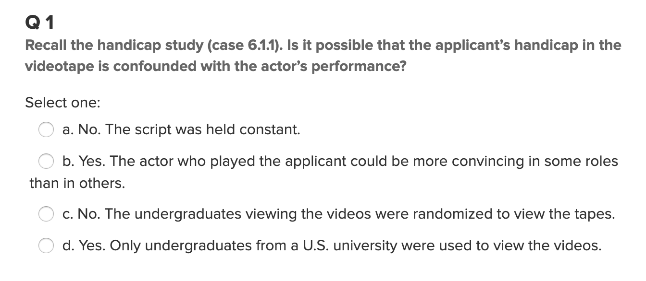
Question 1

Slide 4
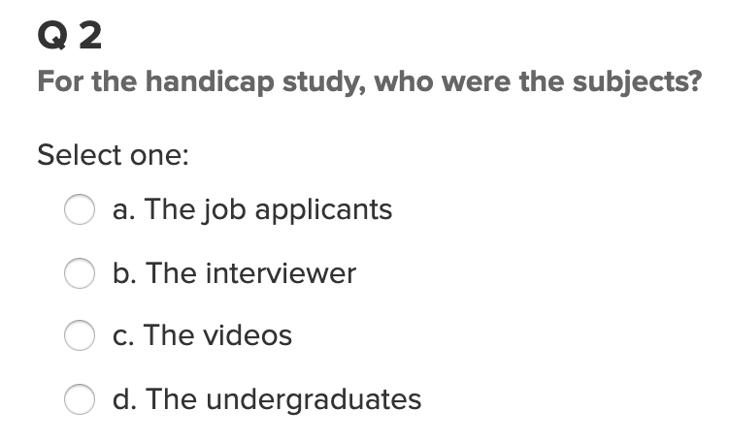
Question 2

Slide 5
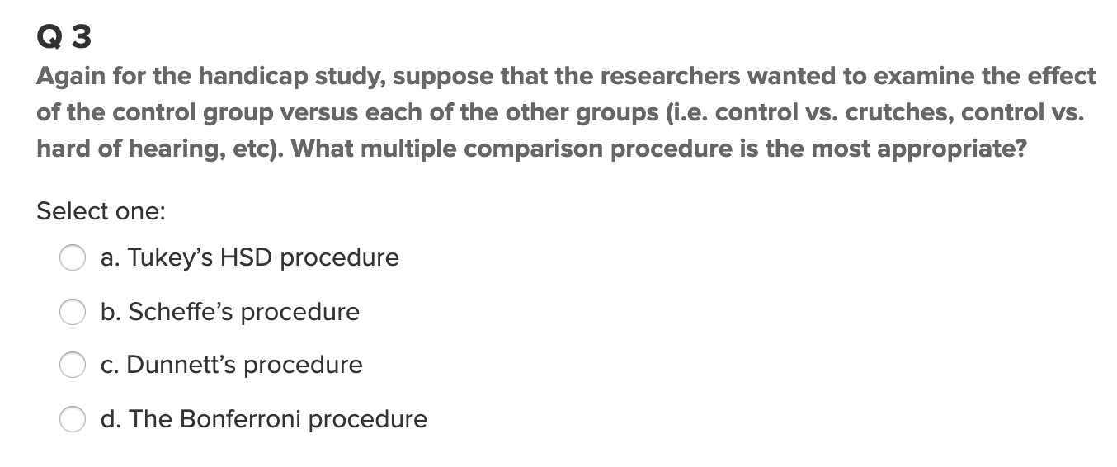
Question 3

Slide 6
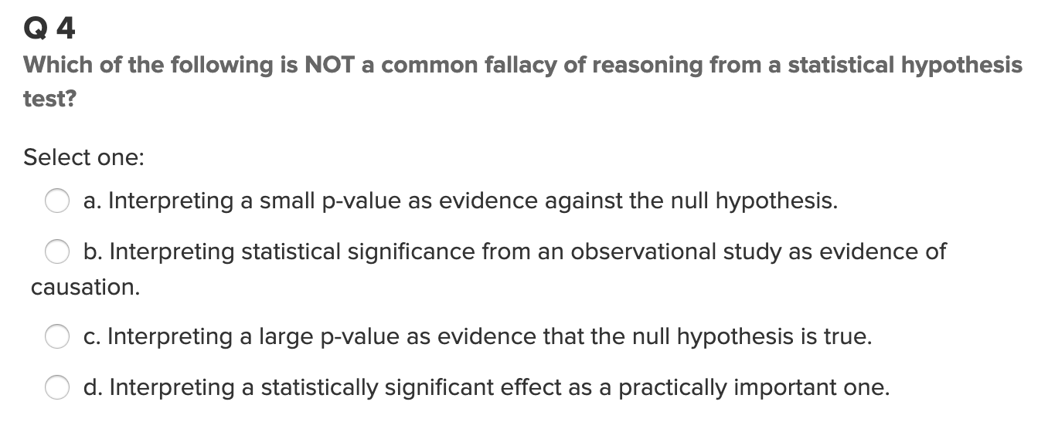
Question 4

Slide 7
End Quick Quiz Questions

Slide 8
A Common Question: How to Find the Contrast Weights and What Are Their Significance?

Slide 9
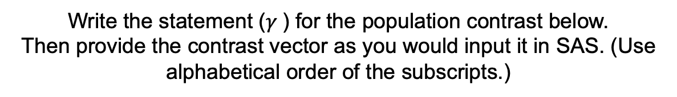
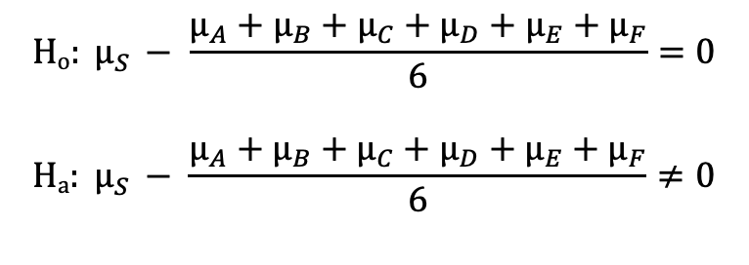

Let’s Try Some!!!
Groups: A, B, C, D, E, F, S
Write the statement ($γ$) for the population contrast below.
Then provide the contrast vector as you would input it in SAS. (Use alphabetical order of the subscripts.)
$$Ho: μ_{S }− \frac{μ_{A}+μ_{B}+μ_{C}+μ_{D}+μ_{E}+μ_{F}}{6}=0$$
$$Ha: μ_{S }− \frac{μ_{A}+μ_{B}+μ_{C}+μ_{D}+μ_{E}+μ_{F}}{6}≠0$$
$$γ=$$
Contrast vector (assume alphabetical order):
Answer on Next Slide ->

Slide 10
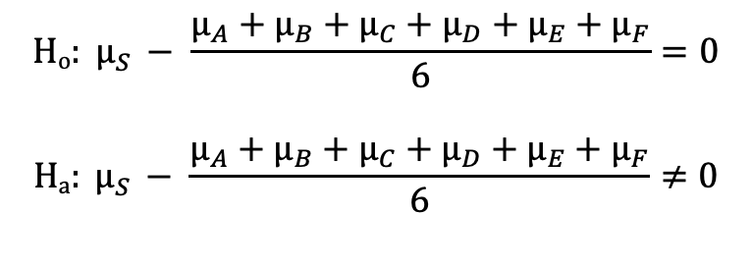
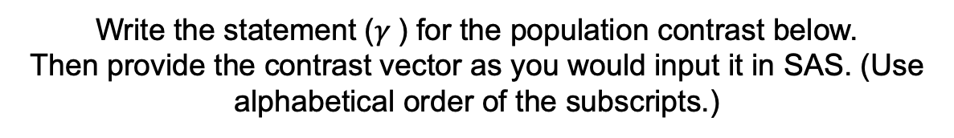
Let’s Try Some!!!
Groups: A, B, C, D, E, F, S
Write the statement ($γ$) for the population contrast below.
Then provide the contrast vector as you would input it in SAS. (Use alphabetical order of the subscripts.)
$$Ho: μ_{S }− \frac{μ_{A}+μ_{B}+μ_{C}+μ_{D}+μ_{E}+μ_{F}}{6}=0$$
$$Ha: μ_{S }− \frac{μ_{A}+μ_{B}+μ_{C}+μ_{D}+μ_{E}+μ_{F}}{6}≠0$$
$γ=−1μ_{A }−1μ_{B }−1μ_{C}$ $−1μ_{D }$ $−1μ_{E }$ $−1μ_{F}$ + $6μ_{S }$
Contrast vector (assume alphabetical order): -1 -1 -1 -1 -1 -1 6

Slide 11
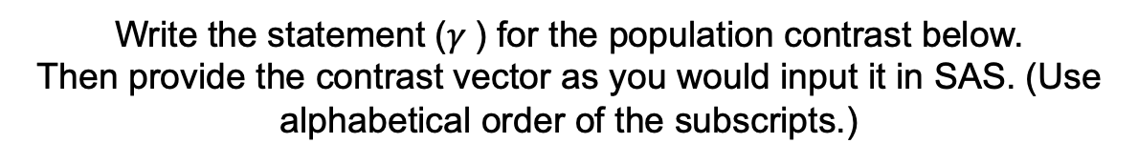
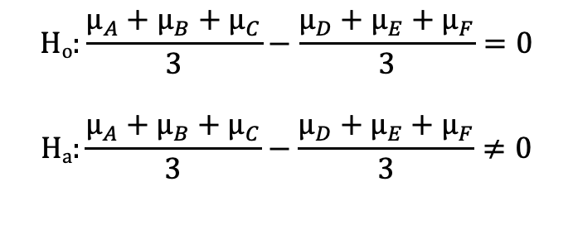

Let’s Try ANOTHER!!!
Groups: A, B, C, D, E, F, S
Write the statement ($γ$) for the population contrast below.
Then provide the contrast vector as you would input it in SAS. (Use alphabetical order of the subscripts.)
$$Ho:\frac{μ_{A}+μ_{B}+μ_{C}}{3}−\frac{μ_{D}+μ_{E}+μ_{F}}{3}=0$$
$$Ha:\frac{μ_{A}+μ_{B}+μ_{C}}{3}−\frac{μ_{D}+μ_{E}+μ_{F}}{3}≠0$$
$$γ=$$
Contrast vector (assume alphabetical order):

Slide 12

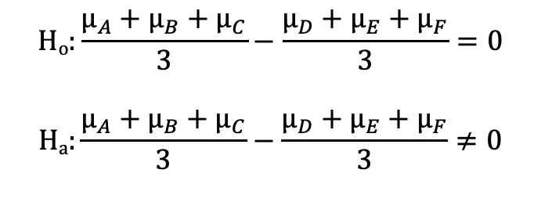
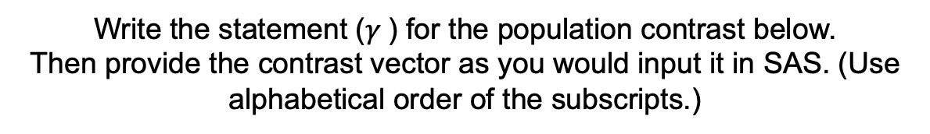
Let’s Try ANOTHER!!!
Groups: A, B, C, D, E, F, S
Write the statement ($γ$) for the population contrast below.
Then provide the contrast vector as you would input it in SAS. (Use alphabetical order of the subscripts.)
$$Ho:\frac{μ_{A}+μ_{B}+μ_{C}}{3}−\frac{μ_{D}+μ_{E}+μ_{F}}{3}=0$$
$$Ha:\frac{μ_{A}+μ_{B}+μ_{C}}{3}−\frac{μ_{D}+μ_{E}+μ_{F}}{3}≠0$$
$γ=$ ${1μ}_{A }+1μ_{B }+1μ_{C}$ $−1μ_{D }$ $−1μ_{E }$ $−1μ_{F}$+ $0μ_{S }$
Contrast vector (assume alphabetical order): 1 1 1 -1 -1 -1 0
ADDITIONAL QUESTION:
Why is it better to include the Spock data in the calculation of the pooled SD (and thus the MSE) even though the hypothesis does not include it?

Slide 13
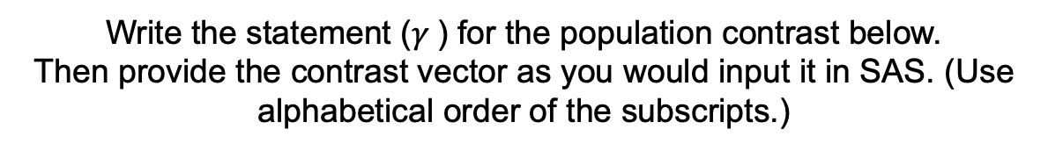
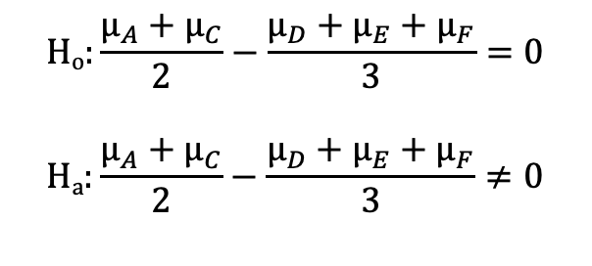

Let’s Try ONE MORE!!!
Groups: A, B, C, D, E, F, S
Write the statement ($γ$) for the population contrast below.
Then provide the contrast vector as you would input it in SAS. (Use alphabetical order of the subscripts.)
$$Ho:\frac{μ_{A}+μ_{C}}{2}−\frac{μ_{D}+μ_{E}+μ_{F}}{3}=0$$
$$Ha:\frac{μ_{A}+μ_{C}}{2}−\frac{μ_{D}+μ_{E}+μ_{F}}{3}≠0$$
$$γ=$$
Contrast vector (assume alphabetical order):
Answer on Next Slide ->

Slide 14
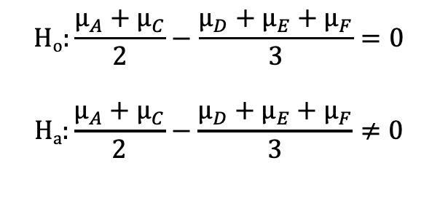
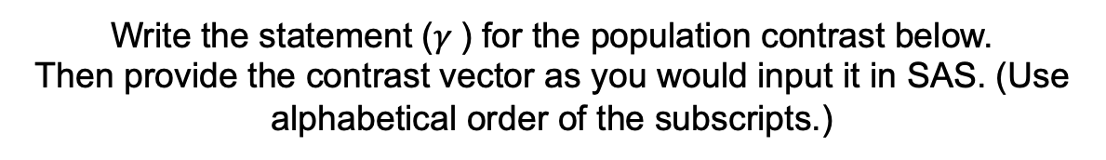
Let’s Try ONE MORE!!!
Groups: A, B, C, D, E, F, S
Write the statement ($γ$) for the population contrast below.
Then provide the contrast vector as you would input it in SAS. (Use alphabetical order of the subscripts.)
$$Ho:\frac{μ_{A}+μ_{C}}{2}−\frac{μ_{D}+μ_{E}+μ_{F}}{3}=0$$
$$Ha:\frac{μ_{A}+μ_{C}}{2}−\frac{μ_{D}+μ_{E}+μ_{F}}{3}≠0$$
$γ=3μ_{A }+0μ_{B }+3μ_{C}$ $−2μ_{D }$ $−2μ_{E }$ $−2μ_{F}+0μ_{S }$
Contrast vector (assume alphabetical order): 3 0 3 -2 -2 -2 0

Slide 15
Job Rating and Effect of Handicap Review

Slide 16
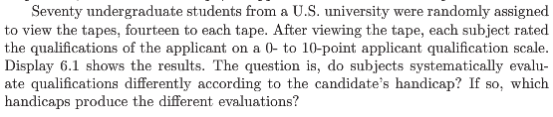
Example: Handicap and Capability Study
Goal: How do physical handicaps affect perception of employment qualification?
(Cesare, Tannenbaum, and Dalessio “Interviewers’ decisions related to applicant handicap type and rater empathy” (1990) Human Performance)
The researchers prepared five video taped job interviews with the same actors.
The tapes differed only in the handicap of the applicant:
No handicap (this is the control group)
One leg amputated
Crutches
Hearing impaired
Wheelchair
Fourteen students were randomly assigned to each tape to rate applicants: 0–10 pts (70 students total).

Slide 17
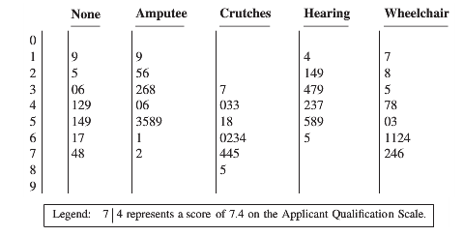
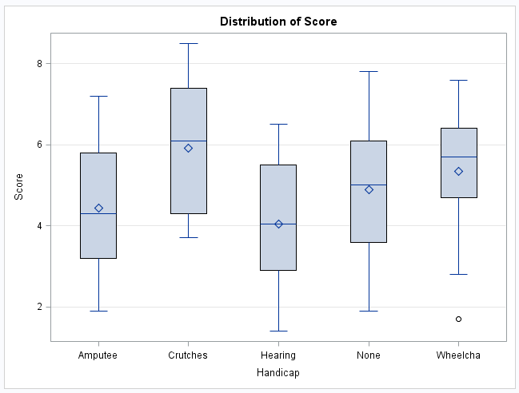
Example: Handicap and Capability Study (cont.)
Do subjects systematically evaluate qualifications differently according to handicap?
If so, which handicaps are evaluated differently?

Slide 18







Is There Any Difference at All?
We should begin any analysis involving several groups by using the ANOVA framework
If there isn’t any (statistically) significant difference in the population means, then there is no reason to address more refined questions
The tapes differed only in the handicap of the applicant:
No handicap (this is the control group)
One leg amputated
Crutches
Hearing impaired
Wheelchair
$${(μ}_{None})$$
$${(μ}_{Amp})$$
$${(μ}_{Crutch})$$
$${(μ}_{Hear})$$
ANOVA: $H_{0}:μ_{1}$=$μ_{2}$=$μ_{3}$=$μ_{4}$=$μ_{5}$
$${(μ}_{Wheel})$$
$H_{A}:μ_{j}≠μ_{k}$ for some $j,k$

Slide 19
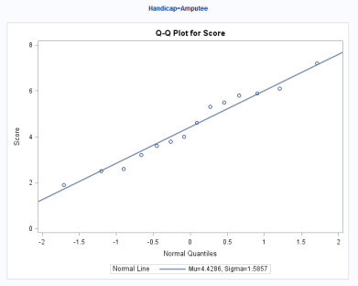
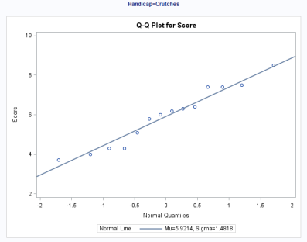
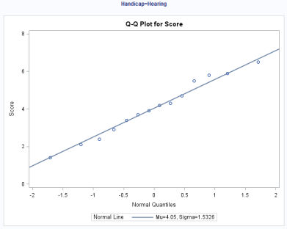
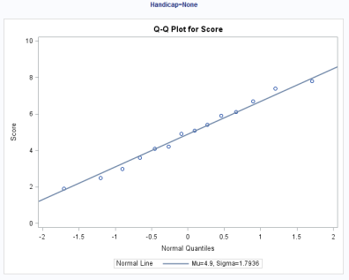
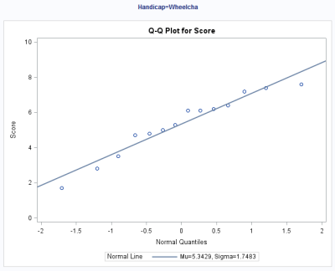
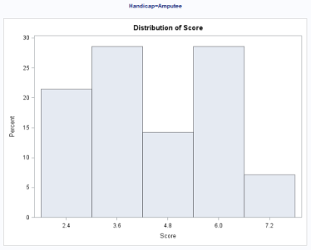
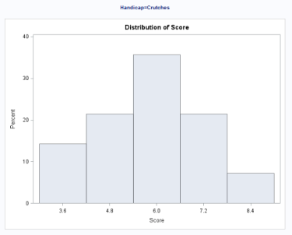
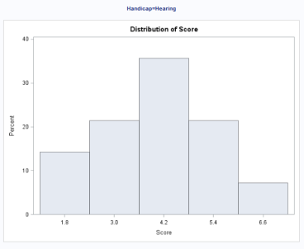
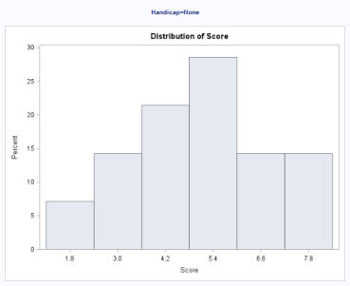
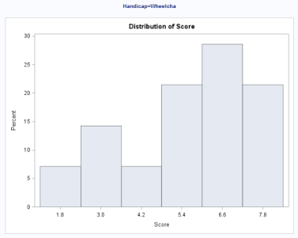
Handicap and Capability Study: Normality Assumption
There is no visual evidence to suggest that the data are not normally distributed. We will proceed with the assumption of normally distributed groups.

Slide 20
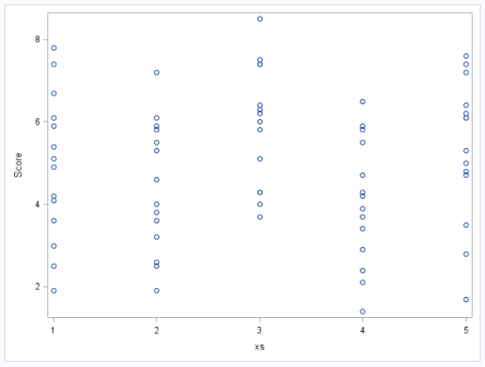
Handicap and Capability Study: Equal Variances Assumption
There is no evidence to suggest variances are unequal.

Slide 21
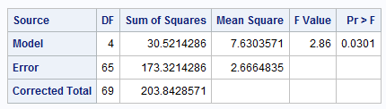
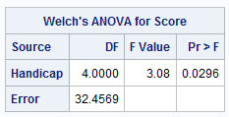


Handicap and Capability Study: ANOVA results
$H_{0}:μ_{1}$=$μ_{2}$=$μ_{3}$=$μ_{4}$=$μ_{5}$ ($μ$)
$H_{A}:μ_{j}≠μ_{k}$ for some $j,k$
There is sufficient evidence to support the claim that at least two population means are different from each other (p-value of 0.0301 from a one-way ANOVA).
Notice that since there is virtually no evidence of a difference in standard deviations, Welch’s test is almost identical to the pure F ANOVA.

Slide 22

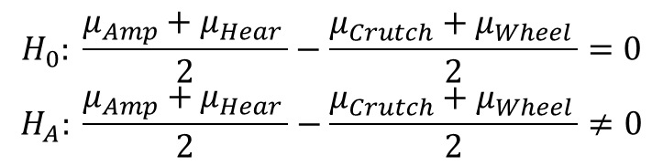
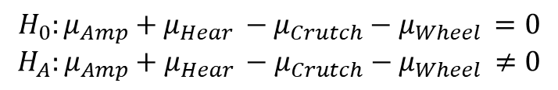

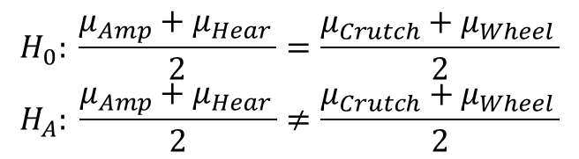

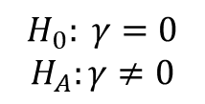

Handicap and Capability Study: More Specific Questions
$$H_{0}: \frac{μ_{Amp}+μ_{Hear }}{2}=\frac{μ_{Crutch}+μ_{Wheel }}{2}$$
$$H_{A}: \frac{μ_{Amp}+μ_{Hear }}{2}≠\frac{μ_{Crutch}+μ_{Wheel }}{2}$$
$$↕$$
$$H_{0}: \frac{μ_{Amp}+μ_{Hear }}{2}−\frac{μ_{Crutch}+μ_{Wheel }}{2}=0$$
$$H_{A}: \frac{μ_{Amp}+μ_{Hear }}{2}−\frac{μ_{Crutch}+μ_{Wheel }}{2}≠0$$
$$↕$$
$$H_{0}:{μ_{Amp}+μ_{Hear }−μ}_{Crutch}−μ_{Wheel }=0$$
$$H_{A}:{μ_{Amp}+μ_{Hear }−μ}_{Crutch}−μ_{Wheel }≠0$$
$$↕$$
(contrast)
$γ=1μ_{amp }−1μ_{Crutch }$ $+1μ_{Hear }$ $+0μ_{None }−1μ_{Wheel}$
$$↔$$
$${ H}_{0}: γ=0$$
$$H_{A}:γ≠0$$

Slide 23



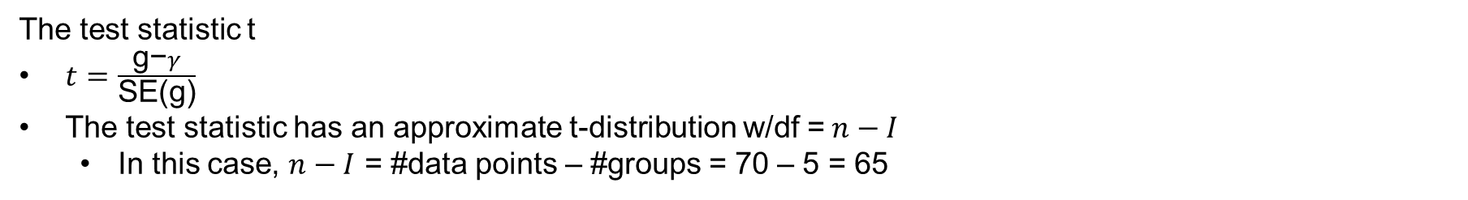

Linear Combinations and Contrasts
(Constraint: $C_{1}+C_{2}+ ⋯+C_{I}=0$)
(this requires independence)
Example: $γ=1μ_{Amp}−1μ_{Crutch}$ $+1μ_{Hear}$ $+0μ_{None}−1μ_{Wheel}$
The test statistic t
$t=\frac{\text{g}\text{−}γ}{\text{SE}\text{(}\text{g}\text{)}}$
The test statistic has an approximate t-distribution w/df =$n−I$
In this case, $n−I$ = #data points – #groups = 70 – 5 = 65

Slide 24
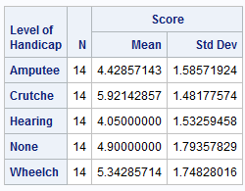
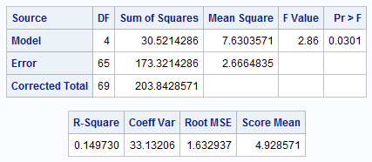
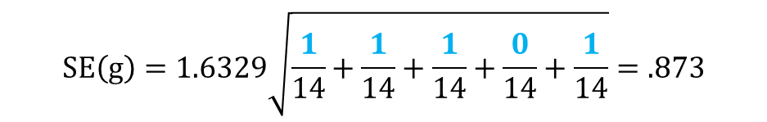
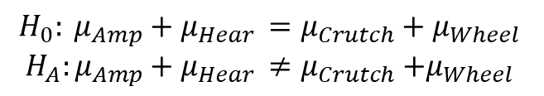
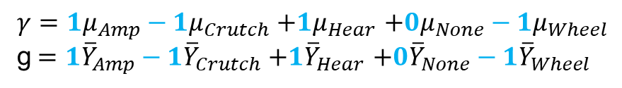
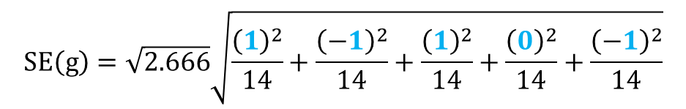
Handicap and Capability Study: A Contrast
Calculate mean difference and standard error.
$$H_{0}: μ_{Amp}+μ_{Hear }=μ_{Crutch}+μ_{Wheel }$$
$$H_{A}:μ_{Amp}+μ_{Hear }≠μ_{Crutch}{+μ}_{Wheel }$$
$γ=1μ_{Amp}−1μ_{Crutch}$ $+1μ_{Hear}$ $+0μ_{None}−1μ_{Wheel}$
g$=1{\overline{Y}}_{Amp}−1{\overline{Y}}_{Crutch}$ $+1{\overline{Y}}_{Hear}$ $+0{\overline{Y}}_{None}−1{\overline{Y}}_{Wheel}$
$g=\left(1\right)4.4−\left(1\right)5.9$ + ($1$)4.1 + (0)4.9 – ($1$)5.3 = - 2.8
$$SE\left(g\right)=\sqrt{2.666}\sqrt{\frac{{\left(1\right)}^{2}}{14}+\frac{{\left(−1\right)}^{2}}{14}+\frac{{\left(1\right)}^{2}}{14}+\frac{{\left(0\right)}^{2}}{14}+\frac{{\left(−1\right)}^{2}}{14}}$$
$$SE\left(g\right)=1.6329\sqrt{\frac{1}{14}+\frac{1}{14}+\frac{1}{14}+\frac{0}{14}+\frac{1}{14}}=.873$$

Slide 25
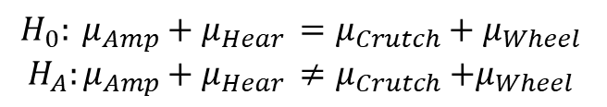
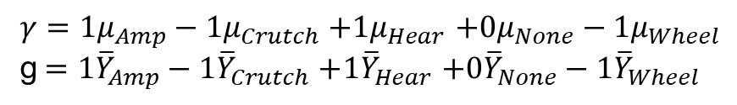


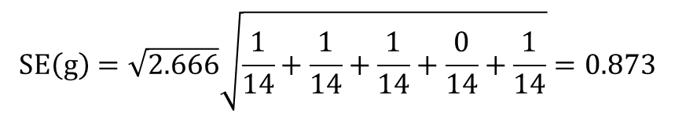

Handicap and Capability Study: A Contrast (cont.)
Confidence intervals for $γ$
$$H_{0}: μ_{Amp}+μ_{Hear }=μ_{Crutch}+μ_{Wheel }$$
$$H_{A}:μ_{Amp}+μ_{Hear }≠μ_{Crutch}{+μ}_{Wheel }$$
$γ=1μ_{Amp}−1μ_{Crutch}$ $+1μ_{Hear}$ $+0μ_{None}−1μ_{Wheel}$
g$=1{\overline{Y}}_{Amp}−1{\overline{Y}}_{Crutch}$ $+1{\overline{Y}}_{Hear}$ $+0{\overline{Y}}_{None}−1{\overline{Y}}_{Wheel}$
$g=\left(1\right)4.4−\left(1\right)5.9$ + (1)4.1 + (0)4.9 – (1)5.3 = –2.8
$$SE\left(g\right)=\sqrt{2.666}\sqrt{\frac{1}{14}+\frac{1}{14}+\frac{1}{14}+\frac{0}{14}+\frac{1}{14}}=0.873$$
CI for the difference of sums: point estimate ± multiplier* standard error
95% t-tools CI for $γ$: $−2.78577 ±(1.9971)(0.87286)$
95% t-tools CI for $γ$: $−2.78577 ±1.74319$
95% t-tools CI for $γ$: (-4.529, -1.043)
There is sufficient evidence that the sum of points assigned to Amp & Hear handicaps is smaller than the sum of points assigned to Crutch & Wheel handicaps at level alpha equal to 0.05 because the CI does not contain 0.
CI for the difference of means
(–4.529/2, –1.043/2)
(–2.2645, –0.5215)

Slide 26
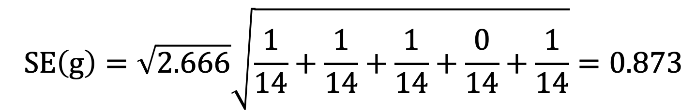
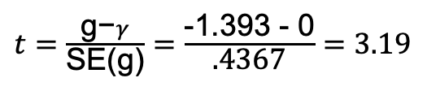
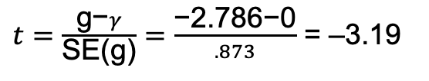
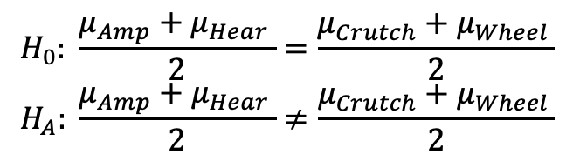






Handicap and Capability Study: In Six Steps
$$H_{0}: μ_{Amp}+μ_{Hear }=μ_{Crutch}+μ_{Wheel }$$
$$H_{A}:μ_{Amp}+μ_{Hear }≠μ_{Crutch}{+μ}_{Wheel }$$
$$H_{0}: \frac{μ_{Amp}+μ_{Hear }}{2}=\frac{μ_{Crutch}+μ_{Wheel }}{2}$$
$$H_{A}: \frac{μ_{Amp}+μ_{Hear }}{2}≠\frac{μ_{Crutch}+μ_{Wheel }}{2}$$
$SE\left(g\right)=\sqrt{2.666}\sqrt{\frac{{\left(.5\right)}^{2}}{14}+\frac{{\left(−.5\right)}^{2}}{14}+\frac{{\left(.5\right)}^{2}}{14}+\frac{{\left(0\right)}^{2}}{14}+\frac{{\left(−.5\right)}^{2}}{14}}$ = $\text{.4367}$
$t=\frac{\text{g}\text{−}γ}{\text{SE}\text{(}\text{g}\text{)}}=$ $\frac{\text{−2.786−0}}{.873}$ = –3.19
$t=\frac{\text{g}\text{−}γ}{\text{SE}\text{(}\text{g}\text{)}}=$ $\frac{\text{−}\text{1.393 }\text{−} \text{0}}{\text{.4367}}=3.19$
$$pvalue= .0022$$
$$pvalue=0.0022$$
$$Reject Ho$$
$$Reject Ho$$
There is strong evidence to suggest that the sum of the means of the amputee and hearing groups is less than that of the crutches and wheelchair groups. (p-value = 0.0022) A 95% confidence interval for the difference is (–4.529, –1.043) points.
There is strong evidence to suggest that the average of the means of the amputee and hearing groups is less than that of the crutches and wheelchair groups. (p-value = 0.0022) A 95% confidence interval for the difference is (–2.2645, –0.5215) points.

Slide 27
Handicap and Capability Study: To the Client
There is strong evidence to suggest that the average of the means of the amputee and hearing groups is less than the average of the means of the crutches and wheelchair groups (p-value = 0.0022). We are 95% confident that the average of the mean scores of the crutches and wheelchair groups are between 0.5215 and 2.2645 points more than that of the average of the mean points of the amputee and hearing groups.

Slide 28



Contrast Designation: SAS
$$H_{0}: \frac{μ_{Amp+}μ_{Hear }}{2}=\frac{μ_{Crutch+}μ_{Wheel }}{2}$$
$$H_{A}: \frac{μ_{Amp+}μ_{Hear }}{2}≠\frac{μ_{Crutch+}μ_{Wheel }}{2}$$
$γ=1μ_{Amp}−1μ_{Crutch}$ $+1μ_{Hear}$ $+0μ_{None}−1μ_{Wheel}$
With no order = data in the code, the contrasts are assigned in alphabetical order, so that “none” group is fourth.

Slide 29

Handicap and Capability Study: R

Slide 30
Break Out Height Example Contrast

Slide 31
Contrasts
We found in the last Unit that there was overwhelming evidence that at least one pair of sports had different mean heights. We ran the extra sum of squares test to find if there was significant evidence to suggest that the mean height of basketball players was different than that of the other sports. Another method to test for this difference is with a contrast. Create a contrast to test to see if there is evidence that that mean height of basketball players is significantly different than the average of the mean heights of the other 4 sports.

Slide 32


Contrast: R

Slide 33



Contrasts: R
$$Ho:μ_{Basketball}=\frac{μ_{Soccer}+μ_{Swimming}+μ_{football}+μ_{tennis}}{4}$$
$$Ha:μ_{Basketball}≠\frac{μ_{Soccer}+μ_{Swimming}+μ_{football}+μ_{tennis}}{4}$$
There is overwhelming evidence to suggest the mean height of basketball players is greater than the average of the mean heights of soccer, swimming, football and tennis players (pvalue < .0001). Our best estimate is that the mean height of the Basketball players is 8.64 inches greater.

Slide 34

Contrasts: R
$$Ho:μ_{Basketball}=\frac{μ_{Soccer}+μ_{Swimming}+μ_{football}+μ_{tennis}}{4}$$
$$Ha:μ_{Basketball}≠\frac{μ_{Soccer}+μ_{Swimming}+μ_{football}+μ_{tennis}}{4}$$
There is overwhelming evidence to suggest the mean height of basketball players is greater than the average of the mean heights of soccer, swimming, football and tennis players (pvalue < .0001). Our best estimate is that the mean height of the Basketball players is 34.6/4 = 8.65 inches greater.

Slide 35




R Example With Contrast Weights Not Adding to 1.
$$Ho:μ_{Basketball}=\frac{μ_{Swimming}+μ_{football}+μ_{tennis}}{3}$$
$$Ha:μ_{Basketball}≠\frac{μ_{Swimming}+μ_{football}+μ_{tennis}}{3}$$
There is overwhelming evidence to suggest the mean height of basketball players is greater than the average of the mean heights of swimming, football and tennis players (pvalue < .0001). Our best estimate is that the mean height of the Basketball players is 8.3 = inches greater.

Slide 36
Rcode for Last Example
fit = lm(Height~Sport, data = SportHeights)
summary(fit)
leastsquares = lsmeans(fit, "Sport")
# Difference of Sums
Contrast = list(BasketballVersusAverageOfFootballTennisAndSwimming = c(3,-1,0,-1,-1))
contrast(leastsquares,Contrast)
#Difference of Averages (Contrast weights add to 1.)
Contrast = list(BasketballVersusAverageOfFootballTennisAndSwimming = c(1,-1/3,0,-1/3,-1/3))
contrast(leastsquares,Contrast)
#Differences of Averages (Conrast Weights do not add to 1.)
Contrast = list(BasketballVersusAverageOfFootballTennisAndSwimming = c(1,.33,0,.33,.33))
contrast(leastsquares,Contrast)

Slide 37
Review: Multiple Comparisons

Slide 38




Third QOI!
Now let’s assume that we are interested in identifying specific differences between any two group means. Find evidence of any differences in the means between the groups.
There are 10 different two-sided tests conducted here; thus, we need to adjust alpha per test to be 0.05/10 = 0.005. With this adjustment, only one of the tests has a statistically significant result. Therefore, there is evidence (p-value = 0.0035 from a t-test) that the crutches and hearing groups have different mean qualification rating scores. We will provide a confidence interval in a few slides.

Slide 39


Multiple Comparisons: Review

Slide 40
Break Out Height Example Multiple Comparison

Slide 41
Multiple Comparisons: Break Out
We found in the last Unit that there was overwhelming evidence that at least one pair of sports had different mean heights. We ran the extra sum of squares test to find if there was significant evidence to suggest that the mean height of basketball players was different than that of the other sports. This time, let’s run every pairwise t-test and perform the appropriate multiple comparison adjustment and see if these results agree with the extra sum of squares test!

Slide 42


Multiple Comparisons

Slide 43
Multiple Comparisons
There is strong evidence to suggest that the mean basketball height is greater than the mean height of each of the other 4 sports (pvalues from a t-test with a Bonferroni multiple comparison correction are all less than .001.).

Slide 44
Break Out Plant Growth Example

Slide 45
Contrasts
Use a contrast to test if the mean yield of the treatment group means is different than the mean yield of the control group.

Slide 46



Contrasts
$$Ho:μ_{Control}=\frac{μ_{Treatment1}+μ_{Treatment2}}{2}$$
$$Ha:μ_{Control}≠\frac{μ_{Treatment1}+μ_{Treatment2}}{2}$$
There is not sufficient evidence to suggest that the mean yield of the control group is different than the average of the mean yields of the Treatment groups (pvalue = .8009 from a contrast (t-test)).

Slide 47
Review: Contrasts

Slide 48



R Code for Handicap Example Question 4
Note: Must Load multcomp package

Slide 49
Multiple Comparisons
Compare Each Treatment group mean to the Control group mean using the most appropriate multiple comparison method.

Slide 50

Multiple Comparisons
There is not enough evidence to suggest that the mean yield of the control group is different than either one of the mean yields of the treatment groups (pvalues: trt1: .323, trt2: .153 with a Dunnett’s multiple comparison correction).

Slide 51
Question 1: Takeaways!
Please provide at least 4 takeaways from this section and any questions that you may have. These questions will help design the live session for this unit.
This question will be the last question of every For Live Session Assignment. The idea is that this deck will serve as a document that you can reference in the future to remember what was covered in this section. For instance, this may come in handy for the Capstone and will hopefully become useful in your career. Most immediately, it may become handy as a quick reference for your Midterm and Final! Some students find it very useful and spend a few slides summarizing the asynch material while others learn different ways and only had the minimum 4 takeaways. Either is fine and will earn you full credit for this question.

Slide 52
Question 2: Questions!
Please provide any question or topics of discussion that came up in this Unit! These will help help us optimize our live session for maximum learning and takeaways!
This question will be the last question of every For Live Session Assignment. The idea is that this deck will serve as a document that you can reference in the future to remember what was covered in this section. For instance, this may come in handy for the Capstone and will hopefully become useful in your career. Most immediately, it may become handy as a quick reference for your Midterm and Final! Some students find it very useful and spend a few slides summarizing the asynch material while others learn different ways and only had the minimum 4 takeaways. Either is fine and will earn you full credit for this question.

Slide 53
End For Live Session Assignment Unit 7!

